Slide 1
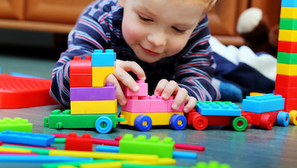
Physical Development in Young Children

Slide 2
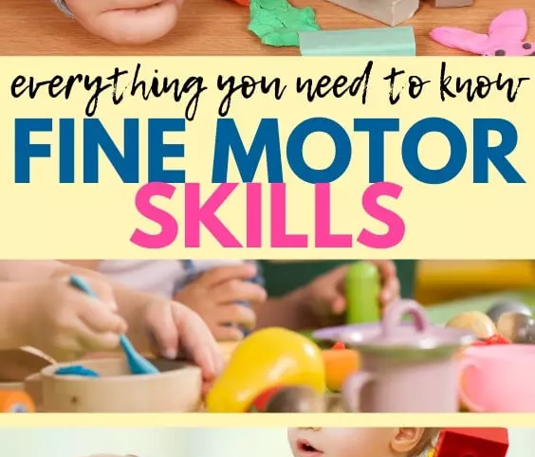
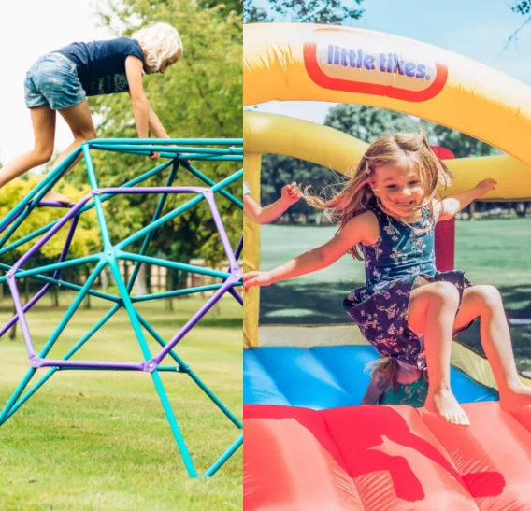
Physical Development is broken up into 2 strands – fine motor and gross motor.
Fine Motor - Fine motor skills involve small muscles working with the brain to control movements in areas such as hands, fingers and eyes.
Gross Motor - Gross motor skills are important to enable children to perform everyday functions like walking, running, climbing, throwing and catching…

Slide 3
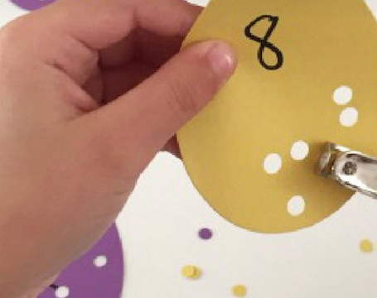
Fine motor Control
Fine motor control is a crucial skill throughout life.
We use fine motor skills in everyday life for basic things such as writing, using a computer and cooking!
If somebody has poor fine motor control they may struggle to do basic jobs.
Good fine motor control starts from birth (babies picking things up and passing from one hand to another).
It is now the perfect time to help your children develop their fine motor control!

Slide 4
What the Government says about Fine Motor
Fine Motor Skills ELG:
Children at the expected level of development will:
• Hold a pencil effectively in preparation for fluent writing – using the tripod grip in almost all cases;
• Use a range of small tools, including scissors, paint brushes and cutlery;
• Begin to show accuracy and care when drawing.

Slide 5
How can I help?
Fine motor development can be encouraged all the time during everyday activities. Some examples of these include:
Cooking/baking (including icing)/mashing
Using sponges to clean the car/windows
Screwing using drivers, nuts or bolts
Encouraging writing
Using pegs
Playing with playdough
Doing jigsaws, threading or weaving games

Slide 6
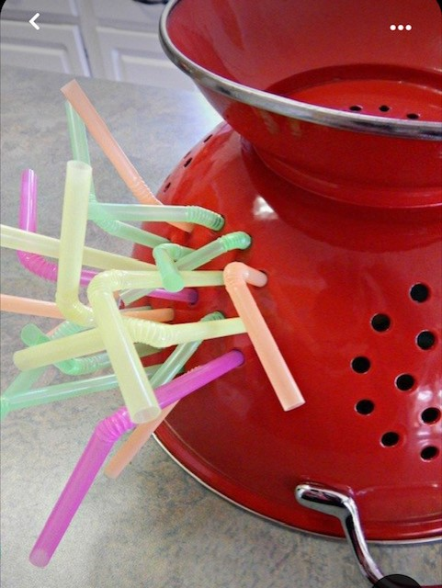
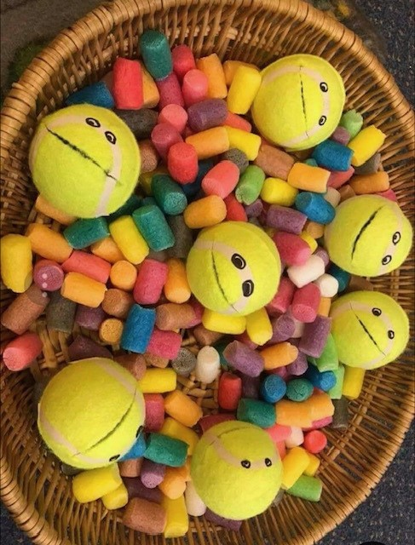
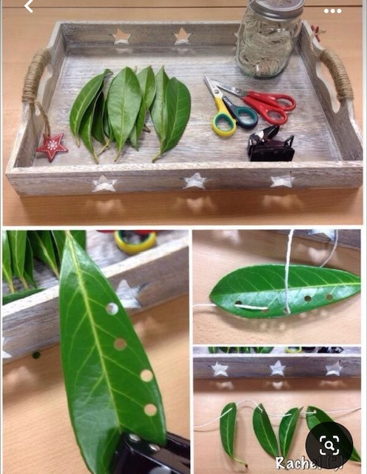
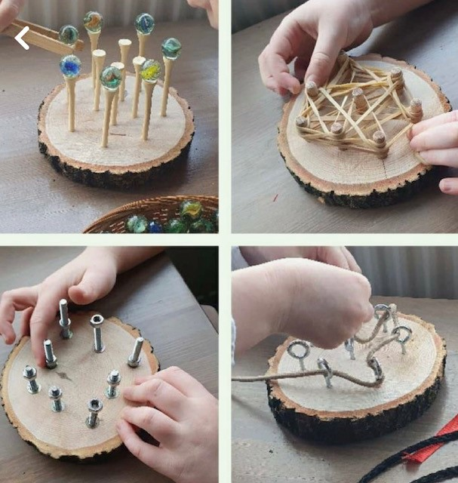
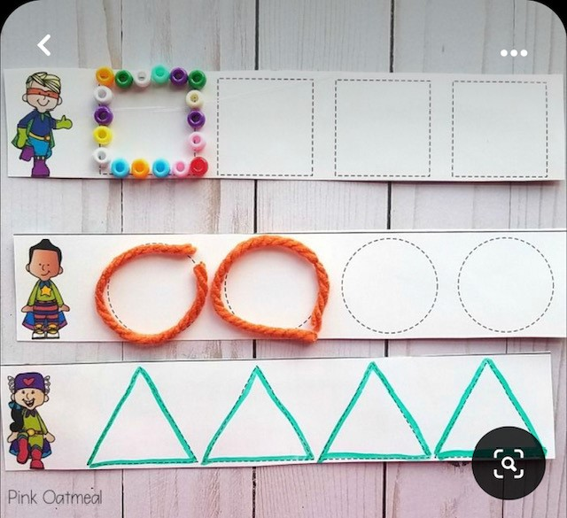
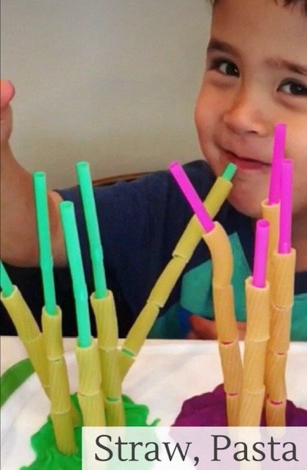
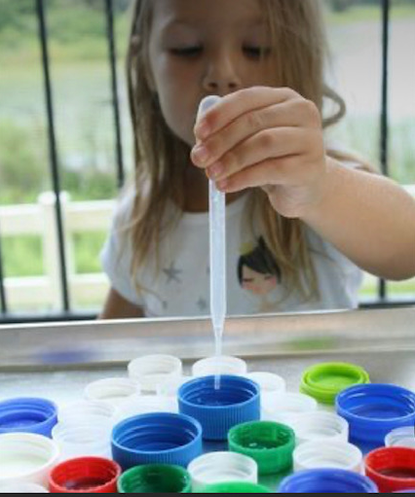
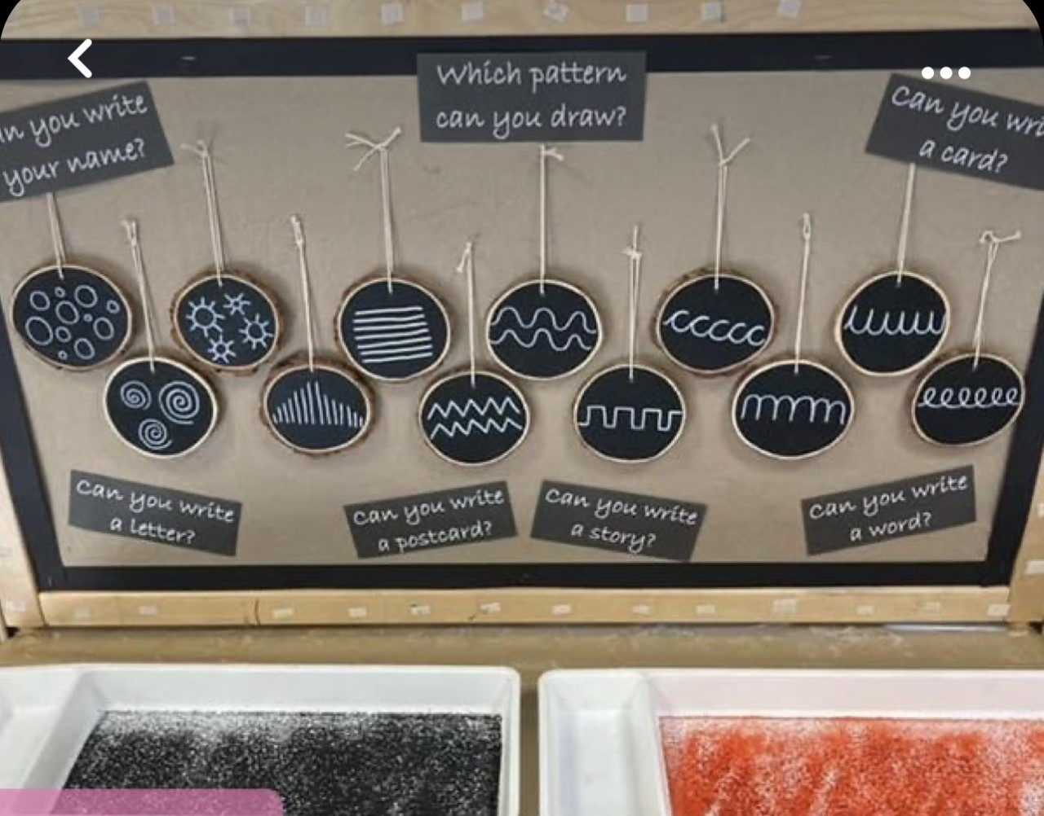
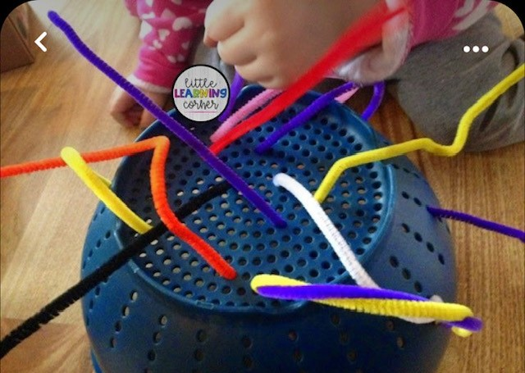
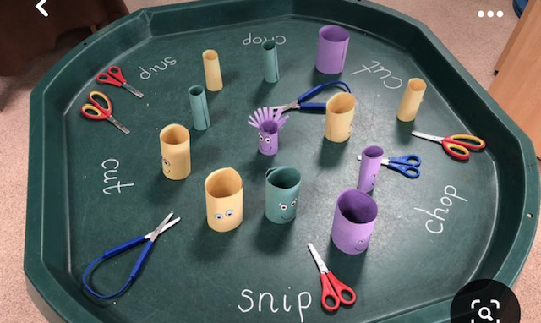
Fine motor!

Slide 7
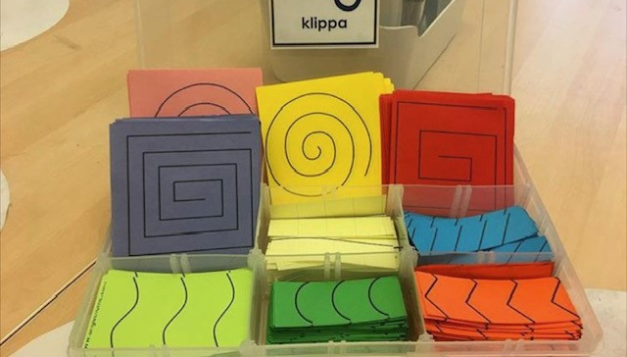
Fine motor development and writing
Fine motor control is the key indicator to how a child performs in writing. A child with good fine motor control will learn how to form letters correctly, draw with detail and have a good stamina for writing.

Slide 9
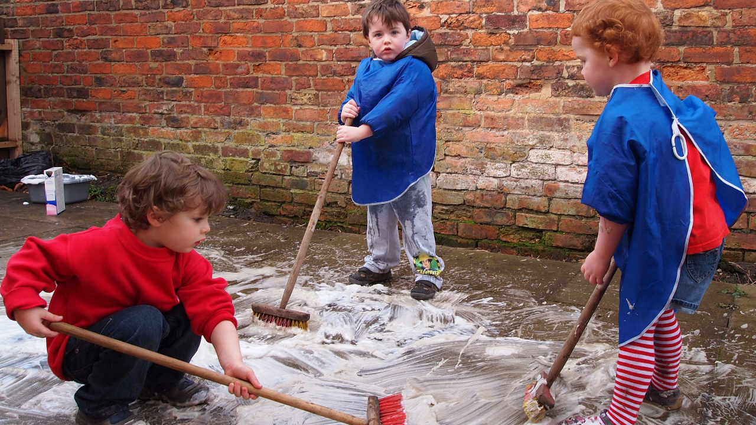
Gross Motor Development
Gross motor control is essential for everyday life. Children constantly learn to develop their gross motor and this comes more naturally to most children.
From birth children learn to develop their gross motor – holding their own head, sitting up, standing, walking, running, jumping....

Slide 10
What the government says about gross motor
Gross Motor Skills ELG:
Children at the expected level of development will:
• Negotiate space and obstacles safely, with consideration for themselves and others;
• Demonstrate strength, balance and coordination when playing;
• Move energetically, such as running, jumping, dancing, hopping, skipping and climbing.

Slide 11
How can I help?
Gross motor development can be encouraged throughout everyday activities in life such as:
Running and jumping
Playing ball games
Following a track
Riding a bike
Climbing in the park
Trampoline
Transporting water on a large scale
Painting the fence with water
Crawling
Using bats and balls
Throwing and catching
Obstacle course
Playing instruments

Slide 12
What happens next?

